Slide 2
SEMANTIC WEB

Slide 3

Topic: Build a
Linked Open Data (LOD) application
Supervisor: Prof. Đỗ Bá Lâm
Students:
Đào Phan Khải 20232206M
Lê Hoàng Long 20232099M

Slide 4
Agenda
Define an ontology for the selected domain
Collect relevant data in this domain
Transform collected data into 4* standard
Find and establish links to other datasets to obtain 5* standard
Provide an interface via SPARQL endpoint/termnal to query data

Slide 5
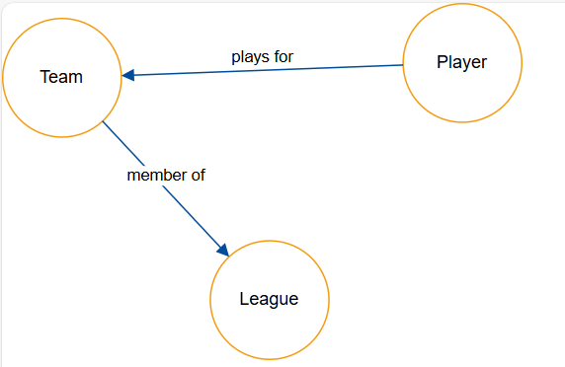
Define an ontology for the selected domain
The selected domain is European football league.
Classes
Team
Player
League

Slide 6
Define an ontology for the selected domain
Attributes
Team
Title
Homepage
Member of league
Link on Wikidata.org
Has players
Season statistics
Goals, Shot per game
Number of yellow card, Number of red card
Percent of ball procession, Percent of successful ball passing
Percent of successful aerial, Rating

Slide 7
Define an ontology for the selected domain
Player
Name
Age
Field position
Nationality
External link on Wikidata.org
Member of a team
League
Title
Description

Slide 8
Collect relevant data in the domain
Original dataset:
https://www.kaggle.com/datasets/vivovinco/20212022-football-player-stats
Processed dataset
https://github.com/hoanglong1712/Dai-Hoc-Bach-Khoa-Ha-Noi/tree/main/Web%20ng%E1%BB%AF%20ngh%C4%A9a%20Semantic%20Web/project%201
Linked dataset:
https://www.wikidata.org/wiki/

Slide 9
Transform collected data into 4* standard
The raw data is in tabular format
Team | Tournament | Goals | Shots pg | yellow_cards | red_cards | Possession% | Pass% | AerialsWon | Rating
Manchester City | Premier League | 83 | 15.8 | 46 | 2 | 60.8 | 89.4 | 12.8 | 7.01
Rk | Player | Nation | Pos | Squad | Comp | Age | Born | MP | Starts | Min | 90s | Goals | Shots | SoT | SoT%
1 | Brenden Aaronson | USA | MFFW | Leeds United | Premier League | 22 | 2000 | 20 | 19 | 1596 | 17.7 | 1 | 1.53 | 0.28 | 18.5
2 | Yunis Abdelhamid | MAR | DF | Reims | Ligue 1 | 35 | 1987 | 22 | 22 | 1980 | 22 | 0 | 0.86 | 0.05 | 5.3

Slide 10
Transform collected data into 4* standard
Step to transform collected data to 4* standard
Use schema.org, xmlns.com, and purl.org
Tournament becomes schema:memberOf
Player becomes schema:member, foaf:name
Age becomes foaf:age
Pos becomes schema:position
Nation becomes schema:nationality
Squad becomes schema:memberOf
Use metadata
Add dct:title
Add dct:license

Slide 11
Establish links to other datasets to obtain 5* standard
Data enrichment
Link to Wikidata.org
Each player has a link to Wikidata.org
Each team has a link to Wikidata.org
Link to homepage
Each team has a link the its official homepage

Slide 12
Interface via SPARQL endpoint/termnal to query data
Collecting name of all teams and leagues
PREFIX : <http://example.org/>
PREFIX xsd: <http://www.w3.org/2001/XMLSchema#>
SELECT ?team ?tournament
WHERE {
?record <http://example.org/Team> ?team ;
<http://example.org/Tournament> ?tournament .
}
Looking for the most scored team
PREFIX : <http://example.org/>
PREFIX xsd: <http://www.w3.org/2001/XMLSchema#>
SELECT ?team ?goals
WHERE {
?record <http://example.org/Team> ?team ;
<http://example.org/Goals> ?goals .
} ORDER BY DESC(xsd:integer(?goals)) LIMIT 1

Slide 13
Interface via SPARQL endpoint/termnal to query data
Looking for teams which process the ball at least 60% of time of all matches
PREFIX : <http://example.org/>
PREFIX xsd: <http://www.w3.org/2001/XMLSchema#>
SELECT ?team ?possession
WHERE {
?record <http://example.org/Team> ?team ;
<http://example.org/PossessionPercent> ?possession .
FILTER(xsd:decimal(?possession) > 60)
}
Counting the number of team
PREFIX : <http://example.org/>
PREFIX xsd: <http://www.w3.org/2001/XMLSchema#>
SELECT (COUNT(?team) AS ?teamCount)
WHERE {
?record <http://example.org/Team> ?team .
}

Slide 14
Interface via SPARQL endpoint/termnal to query data
Looking for teams which get the biggest number of red card
PREFIX : <http://example.org/>
PREFIX xsd: <http://www.w3.org/2001/XMLSchema#>
SELECT ?team ?redCards
WHERE {
?record <http://example.org/Team> ?team ;
<http://example.org/red_cards> ?redCards .
} ORDER BY DESC(xsd:integer(?redCards)) LIMIT 1
Calculating the average number of yellow cards of all teams
PREFIX : <http://example.org/>
PREFIX xsd: <http://www.w3.org/2001/XMLSchema#>
SELECT (AVG(xsd:integer(?yellowCards)) AS ?avgYellowCards)
WHERE {
?record <http://example.org/yellow_cards> ?yellowCards .
}

Slide 15
Interface via SPARQL endpoint/termnal to query data
Sort the list of teams in descending order of ball passing rate
PREFIX : <http://example.org/>
PREFIX xsd: <http://www.w3.org/2001/XMLSchema#>
SELECT ?team ?passPercent
WHERE { ?record <http://example.org/Team> ?team ;
<http://example.org/PassPercent> ?passPercent .
} ORDER BY DESC(xsd:decimal(?passPercent))
Looking for a Premier League team which have more than 80 goals
PREFIX : <http://example.org/>
PREFIX xsd: <http://www.w3.org/2001/XMLSchema#>
SELECT ?team ?goals
WHERE { ?record <http://example.org/Team> ?team ;
<http://example.org/Tournament> "Premier League" ;
<http://example.org/Goals> ?goals .
FILTER(xsd:integer(?goals) > 80)
}

Slide 16
THANK YOU !

